Slide 1
DSF – Digital Service Fulfillment
Presented by : Gauri Wandre 15 April 2025

Slide 2
Project Brief
Purpose
The purpose of the project is to implement a fulfilment solution for Enterprise IOT & SaaS, CaaS products for SOHO & Enterprise customers .
Objective
Develop “Digital Service Order Management Application” for the fulfilment of products (in order to drive efficiency and scalability for the order fulfilment)
Deliver a workflow process
Provide an interface to 3rd Party
The ultimate goal is to deploy and to operate this solution in the AWS cloud
One portal , Many solution
Car/Van tracker
Utility vehicle tracker
Assets & product trackers
Smart Inventory (App-Feature)
SaaS Products ( Vodafone cloud , Microsoft o365, Lookout, Cloud Backup )
Future Scope
Extending the project for the fulfilment of smart data , smart parking products
Notes:
Car Van tracker - SIM card in it
(Tracing of the driver by the van , route tracking & Geo Fencing)

Slide 3
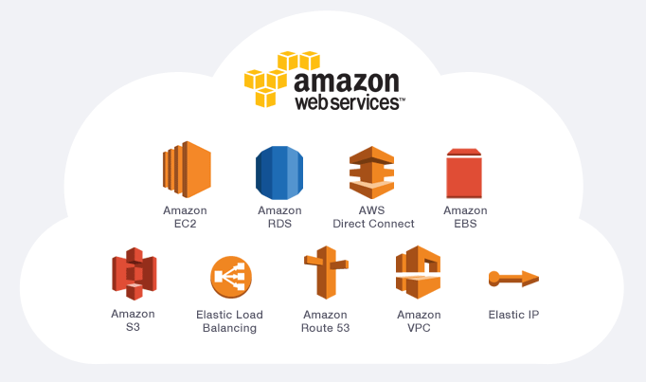

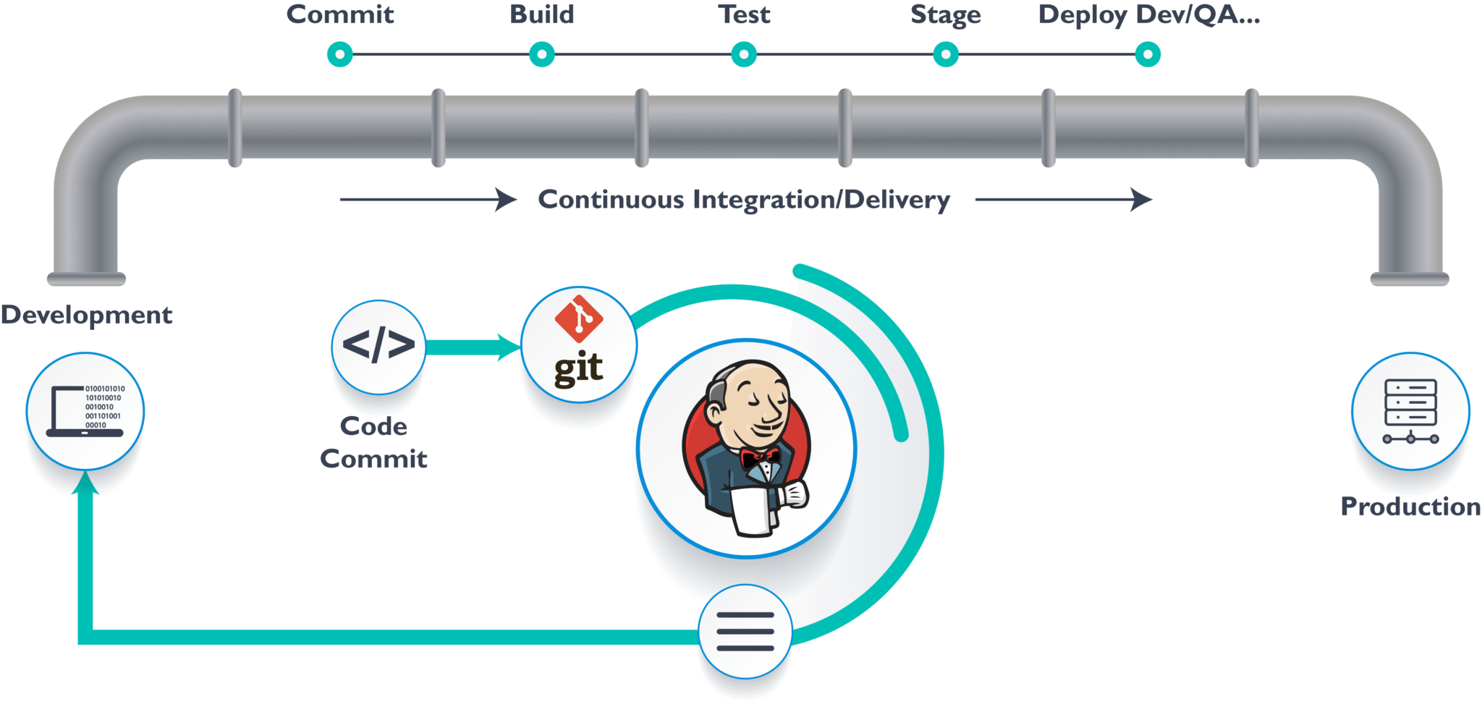

Technologies Used
Cloud Solution
Kubernetes orchestration
RDS Database
Network flows
Infrastructure As Code - Terraform
Server provisioning
Descriptive language
Version Control
Reusability
Deploy through Jenkins CI/CD pipeline
Jenkins CI/CD Pipeline
Automated deployment
Automated Test Execution
Faster Release rate
Platform independent
Notifies build & test results
Pega V8.8.4
BPM technology
Application layer
Deployed on Kubernetes nodes
Provides Docker image
For pega installation on Kubernetes

Slide 4


Monitoring Solution
Currently cloudwatch is used. DSF is planning to move complete monitoring solution to Datadog in future.
Cloudwatch is used to monitor out of box metrics provided & view container/pega logs
PDC
Features of Datadog
Customizable monitoring Dashboards
Alerts Generation
Log Analysis
Event Management
API testing
Real-time data platform

Slide 5
Agile Team
Product Owner Siva Donthireddy Christian Kramer IT Delivery Manager Shashank Sinha
Scrum Master Amruta Desai Development Sumit Nagpal (LSA) Praveen Kesari (LSA) Sumeet Kumar Somenath Panda Hemant M Pranali Sai Teja Santhosh Kirubha Test Rupali Mishra Jacky Roopchandani Jayesh Fuse Aarya Operations Gauri Wandre Madhura Naik Shivani Apate
Program Management Architecture Ahmed Driouach Andreas Winter Stephan Reis Product Manager Oliver Steffens Lars Kloth
Operations Manager Joerg Romswinkel Thomas-Seref Schmidt Business Admin Johanna Daniels Agile Coach Hanns Joerg Durgesh Karvir
System Team Product Owner Matthias Martin AWS Infrastructure Sandip Aigole Raj Chinnadurai
Additional Support Abhishek Jain Rixen Jose
Epic Support SaaS MarketPlace Johanna Daniels Susanne Scholle Birgit Sabrina Lorenz
IoT Tracker/ Inventory Monitoring Manuela Schmitt

Slide 6
Infrastructure Topic

Slide 7
Infra | DSF-Environments
Environments | Managed and Configured By | Responsible Team | Responsibilities
SandBox | System team | System team | Works on the Infrastructure. They develop and test all the infrastructure related code in SANDBOX environment.
DEV | System team | Development team | Initial Development and unit testing would be done here.
SIT | System team | Testing team | All testing are done in this environment.
UAT | System team | Operations team | Used for Business testing. Unit Acceptance testing.
PROD | System team | Operations team

Slide 8
Infra Components
AWS Service | Description
VPC - Virtual Private Cloud | A virtual private cloud (VPC) is a virtual network dedicated to your AWS account. It is logically isolated from other virtual networks in the AWS Cloud.
Region | AWS Region is a separate geographic area
Availability Zones | Each AWS Region has multiple, isolated locations known as Availability Zones
Subnet | A subnet or subnetwork is a smaller network inside a large network. Subnetting makes network routing much more efficient.
VPG - Virtual Private Gateway | Connection to a private (and/or on-prem) datacenter with an AWS VPC
Internet Gateway | Bidirectional connection to the outside world for instance in public subnet via Internet Gateway.
NAT Gateway | Unidirectional connection to the outside world for instance in private subnet .
Transit Gateway | Connection between multiple AWS accounts
Endpoint | Outbound traffic from AWS . Endpoint consumes the Endpoint service
Endpoint Service | Inbound traffic to AWS account

Slide 9
Infra Components Cont….
AWS Service | Description
Route 53 | It is Domain Name System web service. It helps to route the traffic from end-user to internet application.
Route Table | A route table is what decides how traffic flows between subnets. Do you need to move traffic from your public to your private network?
Ec2 | Amazon Elastic Compute Cloud (Amazon EC2) is a web service that provides resizable compute capacity in the cloud
Amazon RDS (Relational Database Service) | It is a fully-managed SQL database cloud service that allows to create and operate relational databases.
S3 bucket | Amazon S3 is a object storage for the internet. You can use Amazon S3 to store and retrieve any amount of data at any time, from anywhere on the web.
EKS | Amazon Elastic Kubernetes Service (Amazon EKS) is a managed Kubernetes service to run Kubernetes in the AWS cloud
High Level Diagram : https://de.confluence.agile.vodafone.com/display/DSF/High+Level+-+AWS+Architecture+Diagram

Slide 10
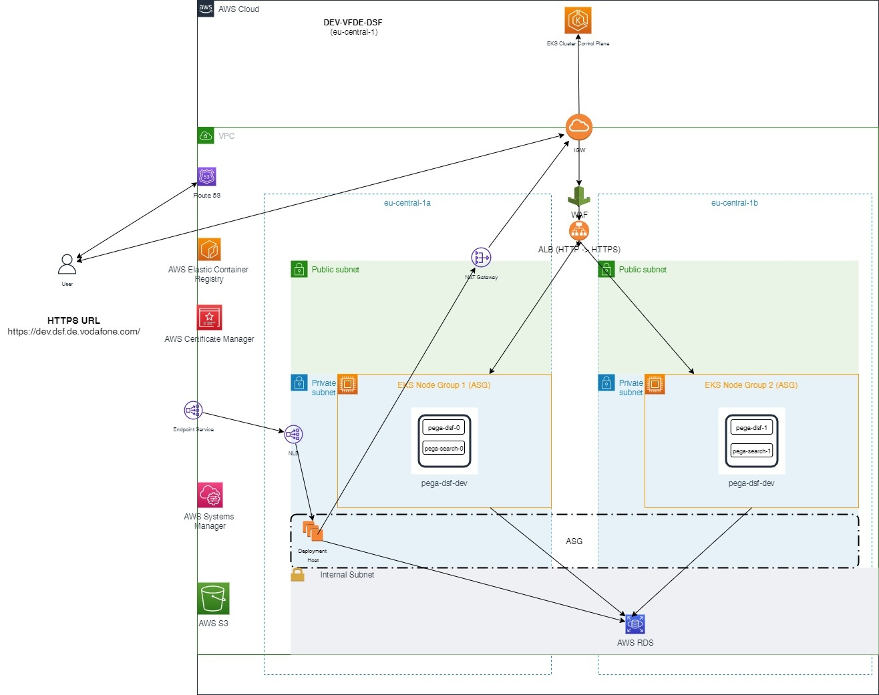
Account Level Diagram

Slide 11
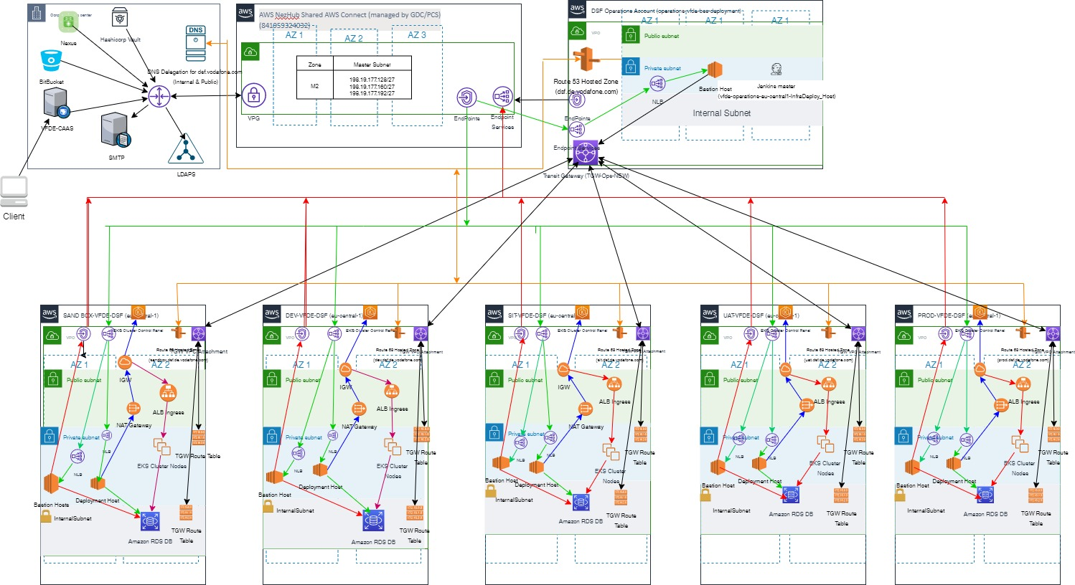
High Level Diagram

Slide 12
Business Flow | IOT Tracker

Slide 13
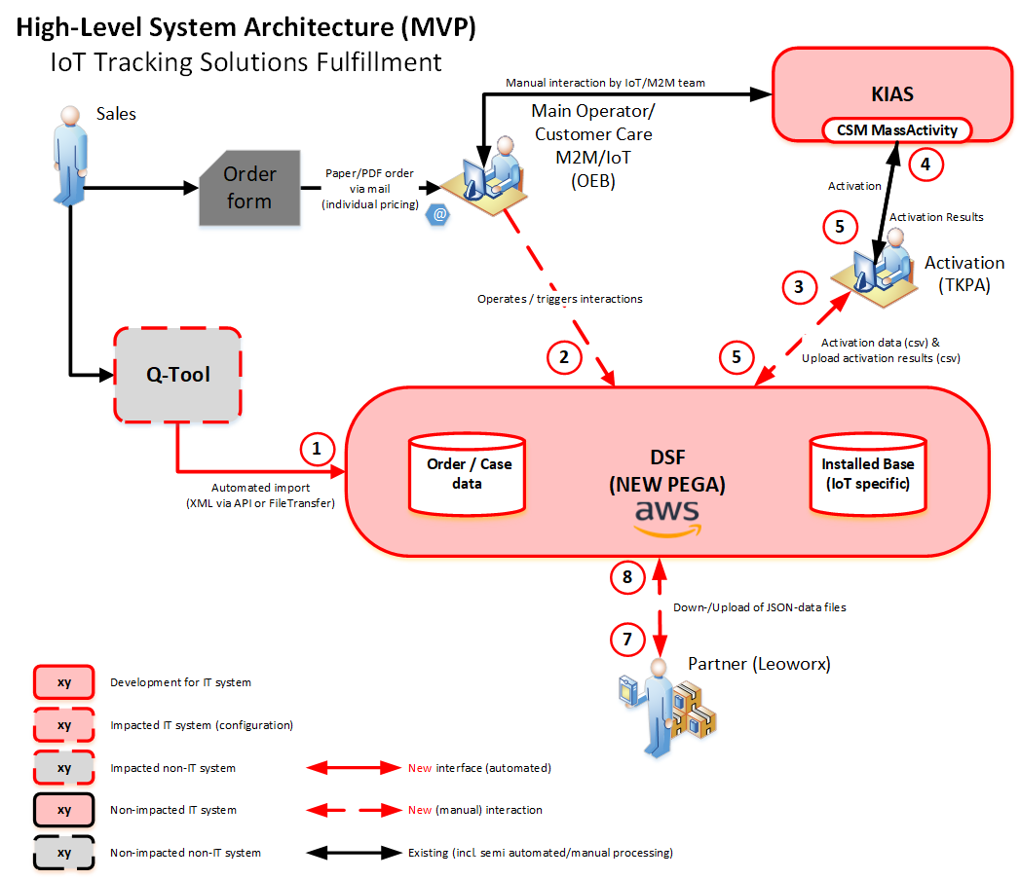
High Level IT Design

Slide 14
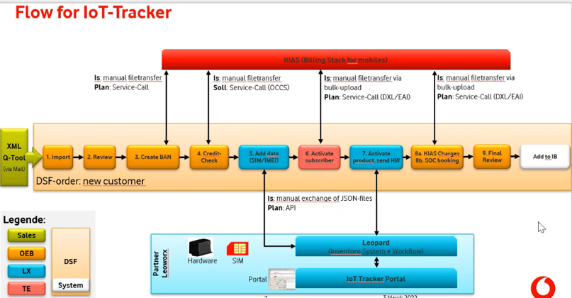

Slide 15
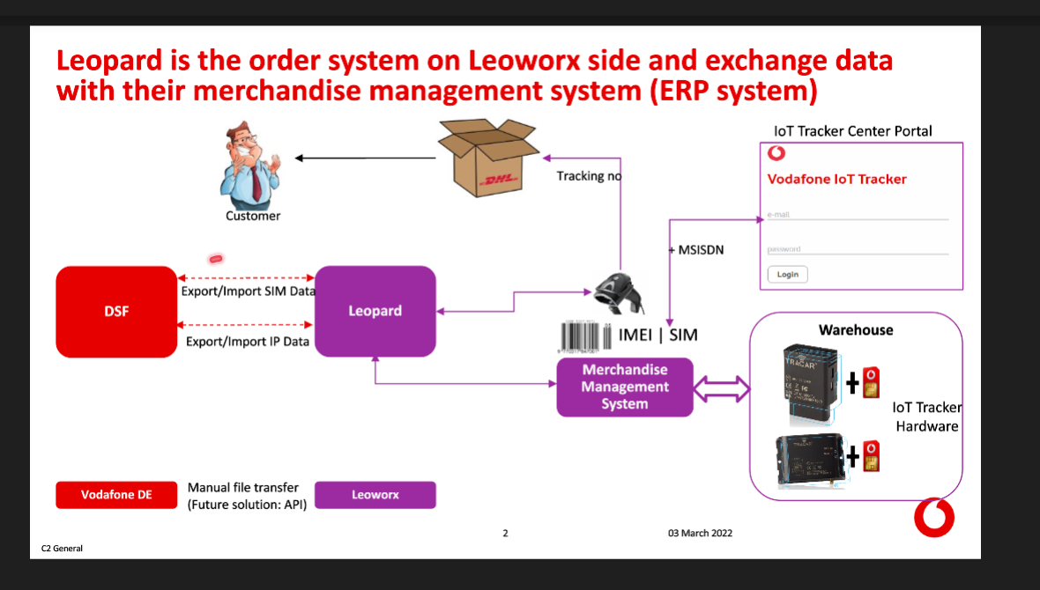

Slide 16
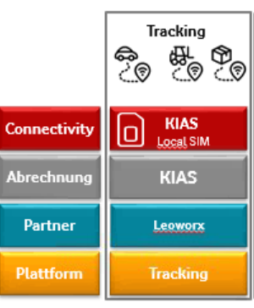
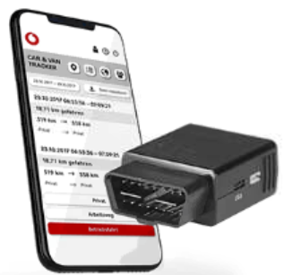
VFDE IOT Solutions
The request would be captured in DSF via Q-Tool / manually
Order will be fulfilled by third party providing plug with sim card & portal
The SIM will be activated by KIAS system & billing will be handled by KIAS
Vodafone IOT tracker info URL :
https://www.vodafone.de/business/loesungen/iot-tracker.html

Slide 17
Stages | Capture & Enrich Order
Capture Stage
Initiate (Status : New)
When a new DSF-XX case is created
Import Order or Manual order (Status : CaptureOrder-InProgress)
When the user either imports a xml or manually enriches the case with order details. At this stage the user enriches the order data.
Enrich Order Stage
Review Order (Status : VisualCheck-InProgress)
This is the case status when the user verifies the data of the order
Capture BAN (Status : CaptureBAN-InProgress)
For new customers, in this step BAN data is captured
Credit Check (Status : CreditCheck-InProgress)
The user performs credit check on this assignment. Credit check is performed offline by the user as there is no integration yet.
Note : OEB department : IOTSolutionsWB , Thirdparty : Leoworx WB , TKPA : FulfillmentMobile WB

Slide 18
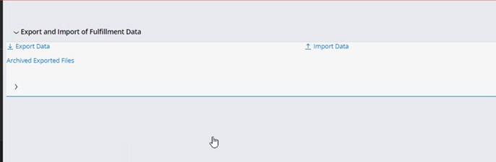
Stages | Fullfil Order
Fulfillment Data
Perform Export SIM Data (Status : PerformExportSIM-InProgress)
JSON file is available to be exported
The case moves to next assignment (PerformImportSIM-InProgress) automatically by batch processing (Queue Processor : resume case )
Leoworks export the file using export functionality at the Administration Tab
Perform Import SIM Data (Status: PerformImportSIM-InProgress)
Leowork imports the SIM & IMEI number using the Import functionality at the Administration Tab
Job responsible for processing these data in DSF : ProcessImportedFulfillmentData

Slide 19
Exception with Import & Export Functionality
No cases in LW workbasket :
Popup with “NoCasesToExport”
Case Locked by another user while export:
Case will be exported but the status will remain as it is “PerformExportSIM-InProgress”. System will try to change the status to “PerformImportSIM-InProgress” 10 times after 30 min (As the lock period is 30 min)
If the requeue was not successful, the case is moved to broken queue.
Checks for Import file :
File size > 0, JSON file, No Blank order ID
Case Locked by another user while import :
The file will not be processed until the lock is released.

Slide 20
Stages | Fullfil Order
Fulfill Order
Export Fulfillment Data (Status : PerformExport-InProgress)
This case satus signifies that the fulfillment team can export the CSV file (comma as delimiter) to enrich it with relevant details like subscriber number, etc.
Import Fulfillment Data (Status : PerformImport-InProgress )
This case status signifies that the fulfillment team can upload the updated CSV file to enrich the order data. Here, mainly subscriber number and SIM success status is given back by fulfilment team.
Fullfillment Finalization
Perform Export IP Data (status :PerformExportIP-InProgress)
JSON file is available to be exported and to be fed into Leopard system.
The case moves to next assignment automatically by batch processing.
Perform Import IP Data (status :PerformImportIP-InProgress)
Leowork imports the IP address, delivery date, delivery note, serial number using the import functionality to the case

Slide 21
Stages | Finalize Order
BANLevelSOC Activation (Status :BANLevelSOCActivation-InProgress)
Only applicable for new customer, this implies that BAN level SOC activation is done.
Addons Billing Activation (Status :ActivateBillingData-InProgress)
This implies as a confirmation that wether addons billing have been activated or not. This assignment and status is only applicable when addons are present in order request.
Final Review (Status :FinalReview-InProgress)
This is final review status before the order gets resolved so that the user can review. After this step the the data is updated in install base database schema.
Resolved-Completed
When the order is successfully resolved

Slide 22
Update To Install Base
Customer Table
Entry will be made in “customer” database only after case is resolved
If new customer, entry will be made in the table
If existing customer, entry will not be made
If existing customer with update on portal administrator name, entry will be updated in the table
Subscriber Table
“Subscriber” table will be updated every time with the fulfillment data
Addon Generic Table
Contain entry of the Add On items

Slide 23
Business Flow | vSIM

Slide 24
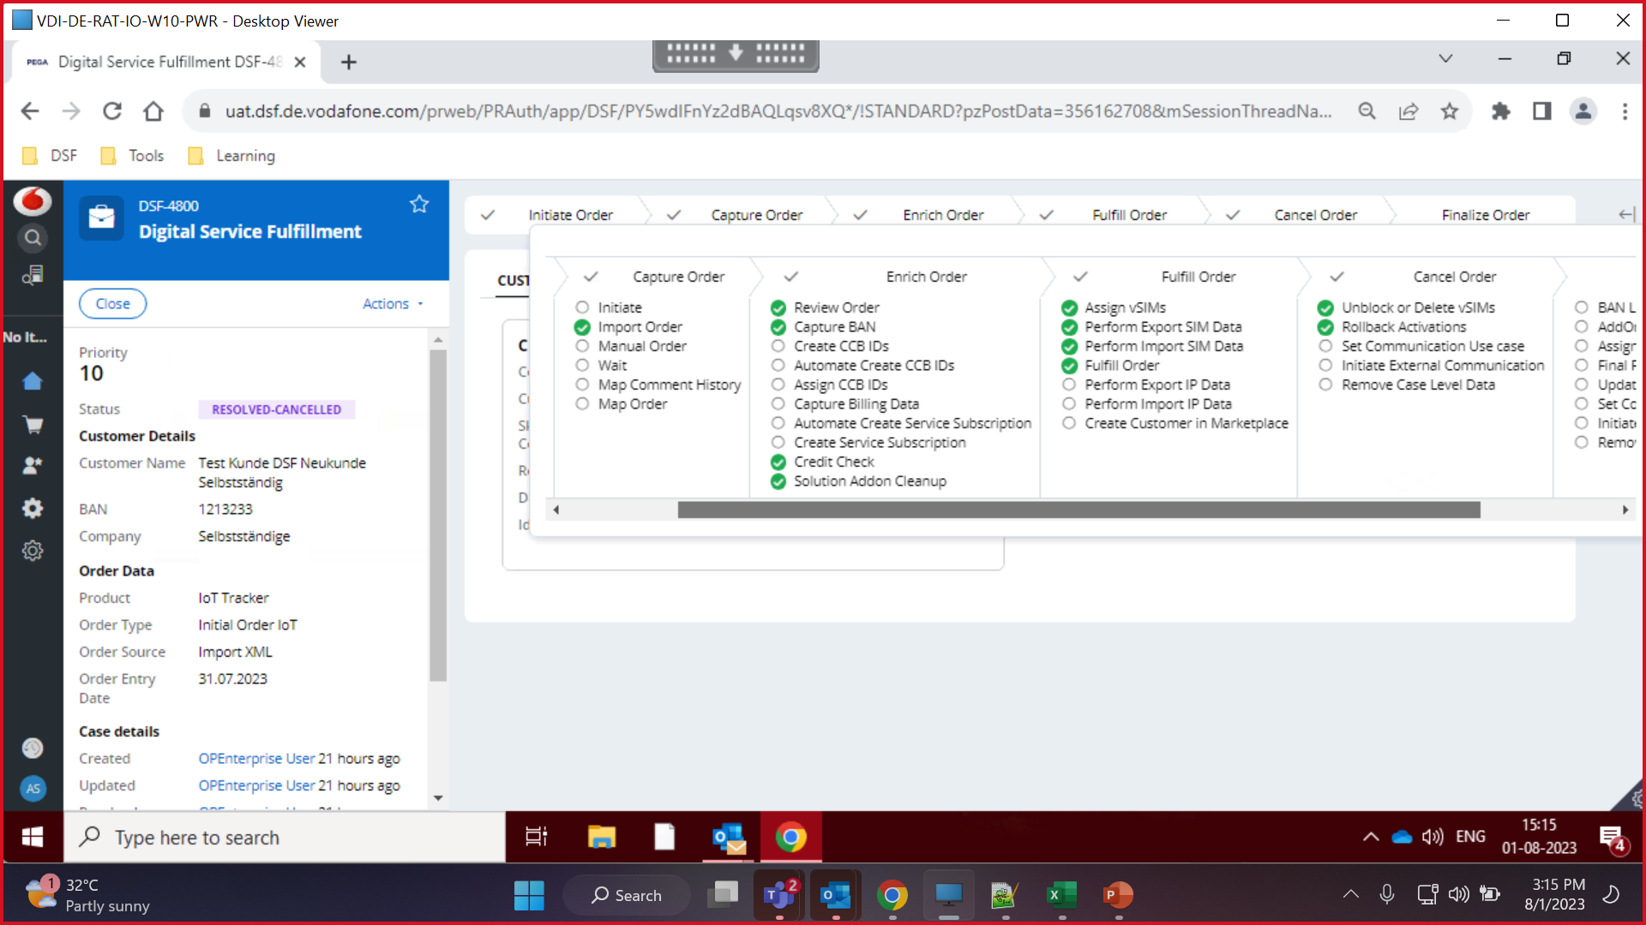

Slide 25
vSIM (Virtual SIM)
SIM cards from Group (GDSP – “Global Data Service Platform” sim) is used for IOT Purposes such as Smart Parking, Asset Tracking, Inventory Monitoring
Billing of customer cannot be done for GDSP sim card in Germany
vSIM is used instead of Physical SIMs to avoid resource wastage & make the process faster without involving Third party for it
The Entire Functionality of vSIMs are divided into 3 parts
Importing of vSIM to DSF
Mapping the vSIM to the case
Handling of vSIM after Mapping

Slide 26
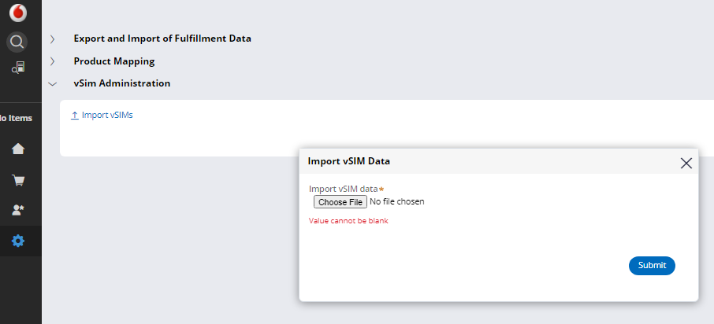
Import VSIM to DSF
The file to be imported will be provided by sergej.astrovski@vodafone.com (KIAS) based on our request .
All vSIM must be of 14 numbers . File will be rejected , if these validations are not met
The file is processed by job “ImportvSIMData” & the vSIM is stored in vSIMData data table
Type Of Processing
Immediate
Number of vSIMs < vSIMProcessingThreshold
Background
Number of vSIMs > vSIMProcessingThreshold
VSIMProcessingThreshold is a DSS

Slide 27
Error Handling
Number of invalid vSIMs > vSIMErrorThreshold
The file will be rejected with “The imported file cannot be processed as it has more invalid SIMs“
Number of invalid vSIMs < vSIMErrorThreshold
The invalid vSIMs will be rejected and a message related to each invalid vSIM will be logged and the rest of vsim will be processed and store into table
vSIMErrorThreshold is the DSS setting
The error message will be logged in vSIMImportStatus datatype table

Slide 28
Mapping the vSIM to the case
vSIM is assigned to individual line items based on the configuration of ‘vSIM Product and Solution Configuration’. This configuration is done by BLMT.
The mapping of vSIMs to the case is done by the job scheduler ‘ProcessVirtualSIM’
Each individual case in TechnicalWB work queue (not in any user workbasket) with status 'AssignvSIMS-InProgress’ will be picked by the job .
During the process of assigning vSIM , if there are technical issues or insufficient vSIMs available then a Technical Clearing (AssignvSIMS-InClearing, ITOperations WB) will be raised at each case level.
Job “VSIMThreshold” checks if the available vSIM count is less the “VSIMThresholdCount” DSS : Once per day

Slide 29
Handling of vSIM after Mapping
Once the vSIMs are mapped to the case , the vSIM number is “Blocked”
vSIM number is deleted from the table by background processor “pzStandardProcessor”, when the activation of vSIM is successful in KIAS
If the case is cancelled before the activation of vSIM , the vSIM is released from “Blocked” to “available” status
If the case is cancelled after the activation of vSIM , vSIM is either deleted/released based on the status of the vSIM activation Success/Failure respectively.

Slide 30
Business Flow | SaaS

Slide 31
SAAS (Software As A Service)
The Vodafone "Software as a Service" Marketplace (SaaS Marketplace) is a platform on which Vodafone offers several SaaS products.
The product portfolio mainly consists of Microsoft 365 licenses but also includes products like Vodafone Cloud Backup and Lookout.
For the future more products from different vendors are planned.
Capturing System: Order Factory / BPA
Fulfillment system: Marketplace (Company : AppDirect)
Billing System: CCB

Slide 32
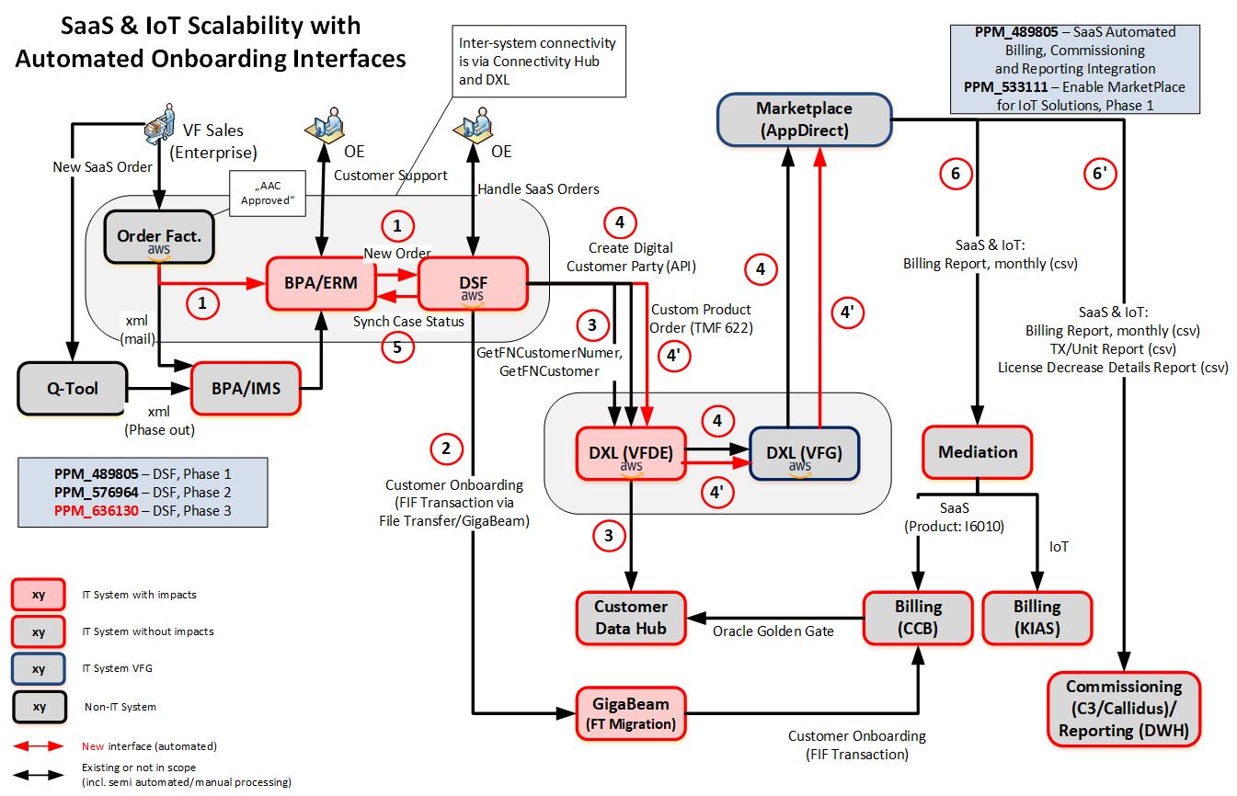
Business Flow | SaaS | High Level IT Design

Slide 33
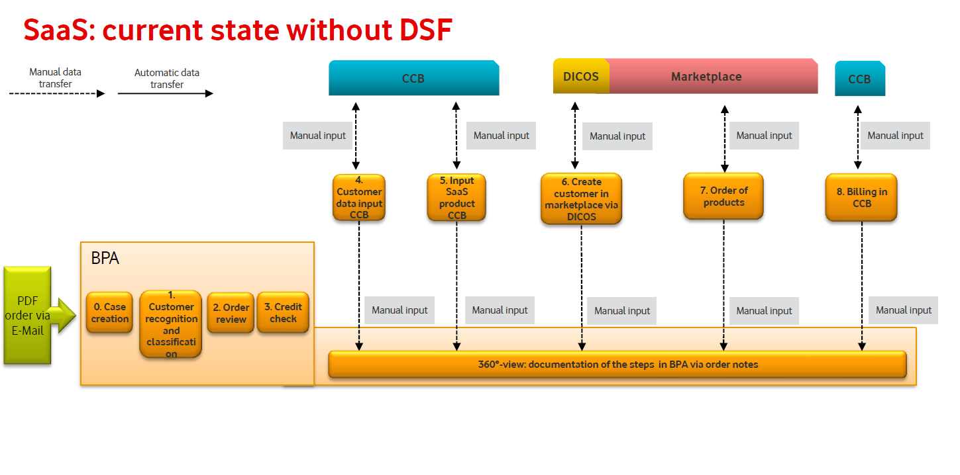
Notes:
DICOS = Not VF application, charges for onboarding customers on hourly basis. Hence scrapped.

Slide 34
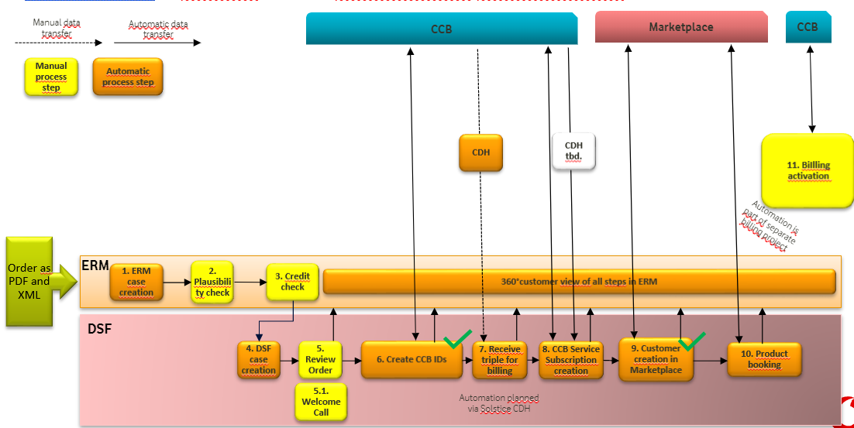
Flow for SAAS
Automatic

Slide 35
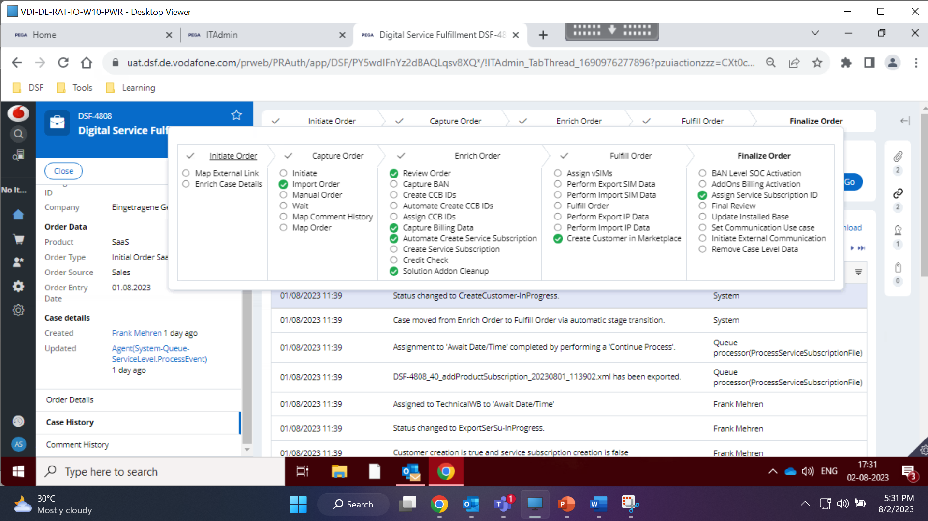

Slide 36
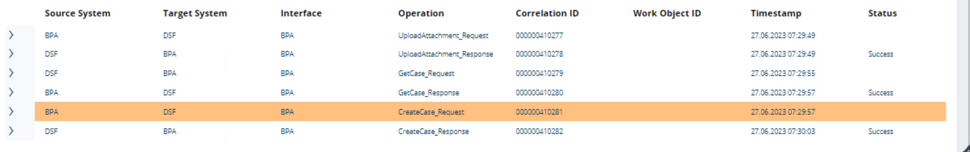
Stages | Initiate Order
BPA send the attachment to DSF via Upload Attachment Service , DSF stores it in service export directory & provides the attachment ID
Create Case Service : BPA sends create case call to DSF with the attachment ID to create the case
DSF triggers GetCase call to receive all the case details from BPA . If the call fails with 404 error ( no case found in BPA) , no case is created in DSF
For any other response , DSF creates the case & provides the case ID in Create Case response
After this , DSF maps the external ID & enriches the case data

Slide 37
Stages | Capture Order
Initiate (Status : New)
When a new DSF-XX case is created
Import Order or Manual order (Status : CaptureOrder-InProgress)
When the user either imports a xml or manually enriches the case with order details. At this stage the user enriches the order data.
Map Order
This process is triggered when the case is created via BPA . The file received from BPA is processed & all the data is attached to the case
Note : OE department : MSOfficeWB ,Followup WB : MSOfficeWiedervorlageWB , ITAdmin : ITOperationsWB , QP request : Technical WB

Slide 38
Stages | Enrich Order
Review Order (Status : VisualCheck-InProgress)
This is the case status when the user verifies the data of the order
They can select if they want manual capture CCB ID / Automate create CCB ID
Manual Create CCB ID
Capture Billing Data (Status : CaptureBillingData-InProgress)
Here business creates the customer ID , Billing Account ID & Product commitment ID, Service Subscription in CCB & captures it in this assignment
If business doesn’t select the checkbox to manual create service subscription , the case will land into Automate Create Service Subscription flow

Slide 39
Stages | Enrich Order
Automate Create CCB IDs
Create CCB ID (Status : ExportCCBFiles-InProgress)
This assignment will provide a screen to business to manually download the CCB files generated by DSF & upload it in S3 bucket
On submission of assignment , the case moves ahead to Followup
Automate Create CCB ID (Status : ExportCCBFiles-InProgress)
DSF creates the files based on business scenario & export the file to S3 bucket . Then resumes the case : Done by QP “ProcessCCBIDFiles”
Followup (Status : CreateCCBIDS-InFollowUp)
The case waits in followup for sometime as per business configuration
Assign CCB ID (Status : AssignCCBIDs-InProgress)
‘Search Customer’ service & ‘Get Customer’ service calls are made & DSF receives the CCB ID’s & map it to DSF case
Automate Create Service Subscription
Create Service Subscription (Status : ExportSerSu-InProgress)
This assignment will provide a screen to business to manually download the CCB files generated by DSF & upload it in S3 bucket
On submission of assignment , the case moves ahead to CreateCustomer-InProgress
Automate Create Service Subscription ( Status : ExportSerSu-InProgress)
DSF creates the files & export the file to S3 bucket . Then resumes the case : Done by QP ProcessServiceSubscriptionFile
Notes:
1) No ID in the XML :
CreateCustomer (createbillingaccount: embedded) , CreateContract
2) Customer ID : Is part of xml
CreateBillingAccount , CreateContract
3) CustomerID , Billing ID is part of xml : CreateContract generated
SearchCustomer : Customer ID from CDH , GetCustomer : Billing Account & ProductCommitment ID

Slide 40
Exception Scenario
Technical Clearing will be raised for below scenarios
If the case is locked , the QP will generate & export the files to S3 bucket but the case will not be moved to next status
The request is then given to the QP “ResumeCasePostProcessingFile” to move the case ahead
Issue | Action
File Generation Failure | ITAdmin checks the message in clearing Perform “Export CCB Files/ Export Service Subscription Files” other action Download the corrupted file for investigation & select the checkbox “Manually Create CCB ID/Service Subscription” The case lands into Capture Billing Data screen to capture the ID’s ( MSOfficeWB)
File Export Failure | ITAdmin checks the message in clearing Perform “Export CCB Files/ Export Service Subscription Files” other action Export the files & place it in S3 bucket . Submit the clearing
Wait Time is breached | Wait Time is set by ITAdmin for the QP to process the case . If the QP doesn’t process the case within the mentioned time , case lands into Clearing Perform “Export CCB Files/ Export Service Subscription Files” other action Export the files & place it in S3 bucket . Submit the clearing

Slide 41
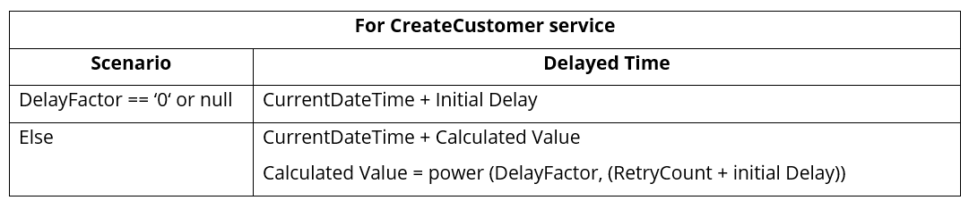
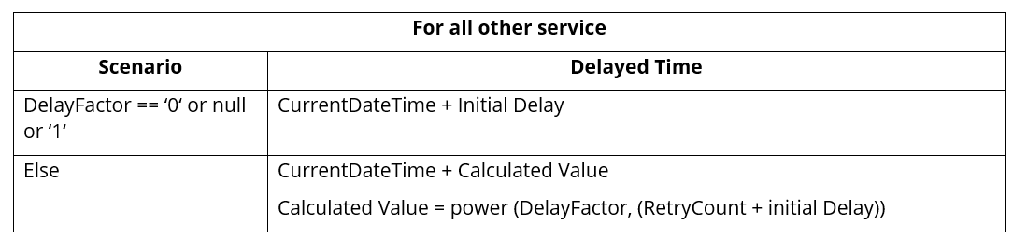
Stages | Fulfil Order
Create Customer in Marketplace (Status : CreateCustomer-InProgress)
Customer is onboarded in Marketplace using the “CreateCustomer” REST service
Error Handling for service calls
If there are any technical issue for CDH/Marketplace services , clearing will based on MapTheNextSteps DT .
If RetryReq == ‘true‘ && retrycount < MaxRetry , then retry of the service is initiated as per calculated delayed time.
Upon submission of technical clearing , the service will be called again
Retry Calculation

Slide 42
Stages | Finalize Order
Assign Service Subscription ID
Followup (Status : AssignSerSu-InProgress)
The case waits in followup for sometime as per business configuration (after customer creation in marketplace)
Assign Service Subscription (Status : AssignSerSu-InProgress)
GetServiceSubscription call is made to CDH to retrieve the subscription ID & map it to DSF case
Final Review (Status : FinalReview-InProgress)
This is final review status before the order gets resolved so that the user can review.
‚Send Booking communication to BPA/ERM‘ if this check box is tick , Set Communication Use case process runs in background to add automated email list to PerformAssignment Request
Once final review is submitted , case is Resolved-Completed
Notes:
1) No ID in the XML :
CreateCustomer (createbillingaccount: embedded) , CreateContract
2) Customer ID : Is part of xml
CreateBillingAccount , CreateContract
3) CustomerID , Billing ID is part of xml : CreateContract generated
SearchCustomer : Customer ID from CDH , GetCustomer : Billing Account & ProductCommitment ID

Slide 43
Stages | Finalize Order
Initiate External Communication
The case is queue for external communication & is worked upon by “QueueExternalCommunication” QP
GetCase service is called from DSF to receive the status of BPA case .
In the response if the BPA case is in "Wait for DSF fulfilment" , then PerformAssignment call is triggered from DSF to communicate closure/cancellation along with automated emails
No retry of Perform Assignment is done in DSF as of now , hence you should inform business on daily basis for any failure so that they can push the case in BPA ahead

Slide 44
Important DB tables
DB Table | Schema | Purpose
Pc_vdf_de_dsf_work | prpc_data_adm | Contains details about the work object created for DSF application
Pc_history_vdf_de_dsf_work | prpc_data_adm | Contains the audit history for the work object
Pr_vdf_data_exportimport | prpc_data_adm | Contains processing status of the file imported by Leoworx
customer | DSF_INSTALLED_BASE | Contains new customer details for IOT Tracker
Subscriber | DSF_INSTALLED_BASE | Contains the detail of the solutions ordered for IOT Tracker orders
Addons_generic | DSF_INSTALLED_BASE | Contains the detail of the Add-On ordered for IOT Tracker orders
pr_sys_queues | prpc_data_adm | Table contain details about the items which are queued to be processed by QP
pc_assign_workbasket/pc_assign_worklist | prpc_data_adm | holds assignments in work queues/work list

Slide 45
Task involved for L2 support
Incident management analysis & testing the solution
Service request handling in order to perform any configuration changes
Managing performance, stability and reliability of DSF application
Monitoring of application with the ability to avoid issues
Working in alignment with DEV team to understand the upcoming features
Understanding the user stories & providing operational requirements
Updating runbook for new features going live
Support activities ( Deployment alignment & activity ,testing,bug analysis) on UAT environment
Pega UVU reporting to SAM licensing team

Slide 46
Access
Application | Access
Confluence | https://de.jira.agile.vodafone.com/servicedesk/customer/portal/
JIRA | https://de.jira.agile.vodafone.com/servicedesk/customer/portal/6
AWS Console | https://de.confluence.agile.vodafone.com/display/DSF/DSF+-+AWS+AD+Security+Groups
DSF PROD | https://prod.dsf.de.vodafone.com/prweb/PRAuth/app/DSF/
DSF UAT | https://uat.dsf.de.vodafone.com/prweb/PRAuth/app/DSF/
DSF SIT | https://sit.dsf.de.vodafone.com/prweb/PRAuth/app/DSF/
Datadog | https://de.confluence.agile.vodafone.com/display/SOLS/CIM+Operation+-+How-To+-+Request+Access+to+Datadog
BitBucket | AD group app-de-dev-dsf from Ngum has RW access but no impact as write access requires merging & approval
Jenkins

Slide 47
Document Repository
All the necessary information and documents related to DSF application for all the environments can be found on Project and Operations Confluence Page.

Slide 48
Thank you

